Slide 1
Exploring the influence of geometric shapes on the flow field
Current Research Overview
Last update: 12/05/2024

Slide 2
Background
When working on the SALP robot, we encountered an issue with the second robot
shell: due to laser cutting inaccuracies, the bending rate of the second robot was lower than that of
the first, resulting in a significantly lower speed. Considering that the current robot shape has not
been optimized, I want to optimize the current robot shape to its best possible configuration before
proceeding with further functional design, laying a solid foundation for subsequent experiments.
Method
Set up a PIV system and fix robots of different shapes in the water. Then, use the PIV system to observe jet propulsion and determine the optimal shape by comparing differences in the velocity fields.

Slide 3
Current Progress
1. Experiment environment setting up
2. PIV system setting up from zero
3. Flow velocity field calculation
4. Robotics simulation

Slide 4
Experiment environment setting up
Our experimental setup consists of three components:
Fish Tank System: The fish tank is secured within our large water pool using 80/20 aluminum alloy to stabilize the tank. This setup allows us to position the laser head inside the tank and adjust it to the desired height, illuminating the water surface at the required depth.
Window System: An acrylic plate is crafted into a window and pressed onto the water surface. This system is designed to observe the robot while avoiding the interference of free surface waves, ensuring the camera captures precise images.
Camera System: The camera is mounted on an X95 rail attached to an aluminum frame on the ceiling. This ensures the camera's observation plane remains horizontal. Instead of adjusting the camera's height, we will fine-tune the focus to clearly observe the flow field.

Slide 5
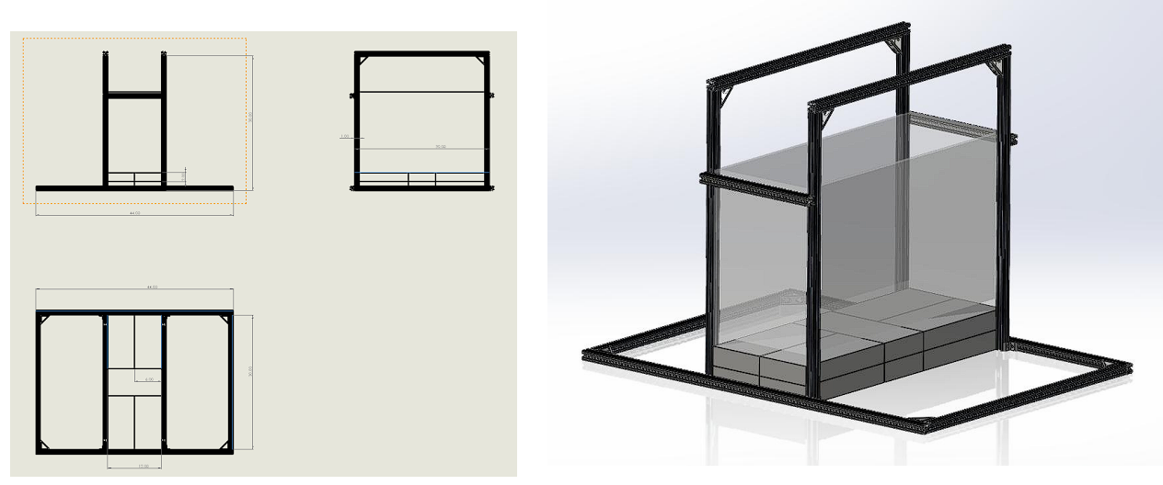
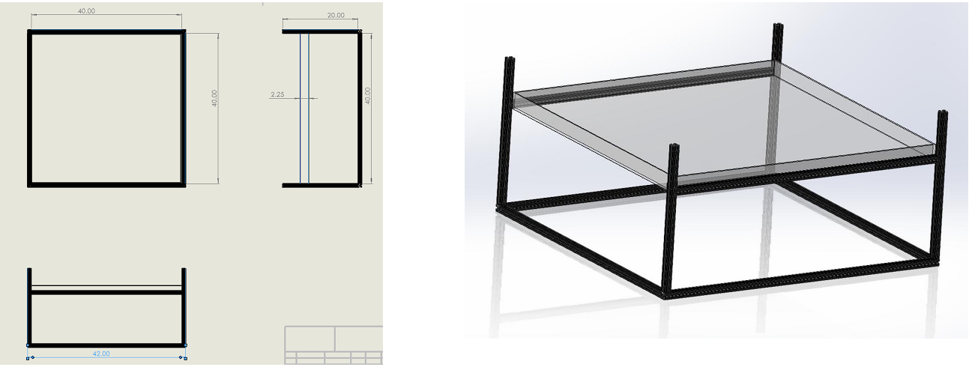
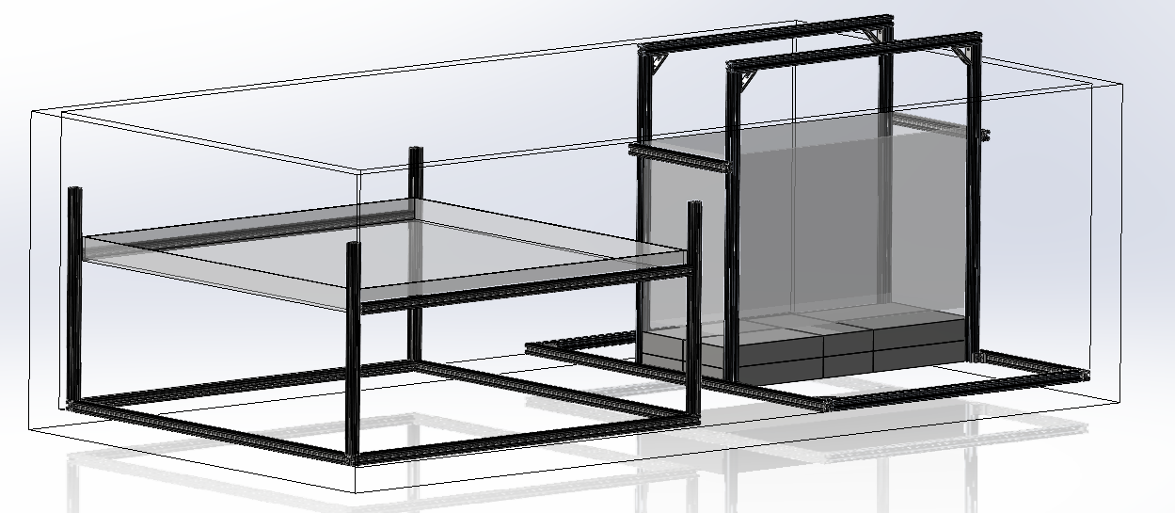
Experiment environment setting up
Fish tank system
Window system
Whole
system

Slide 6
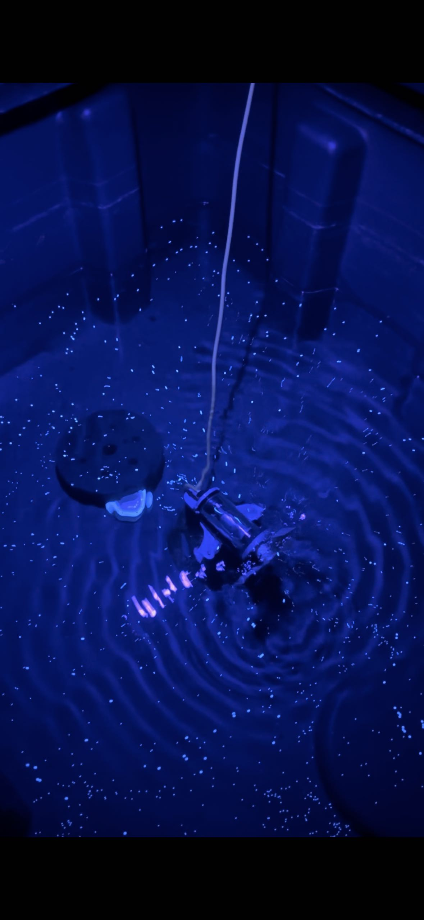
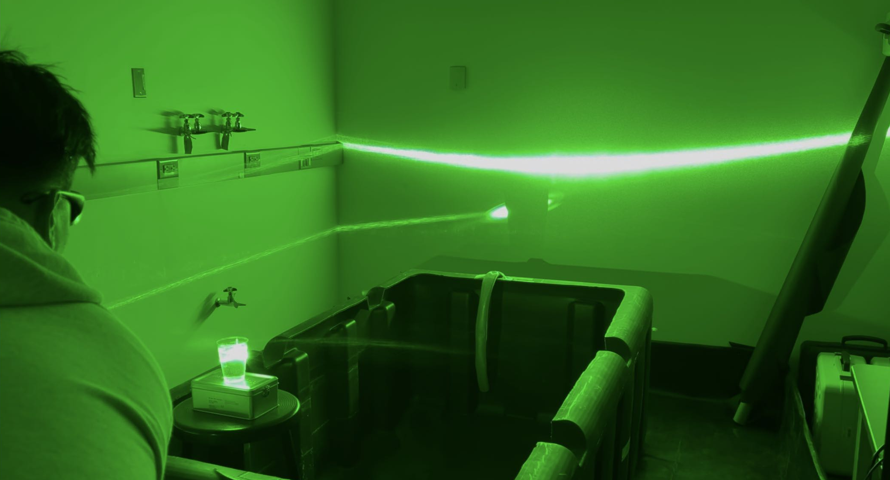
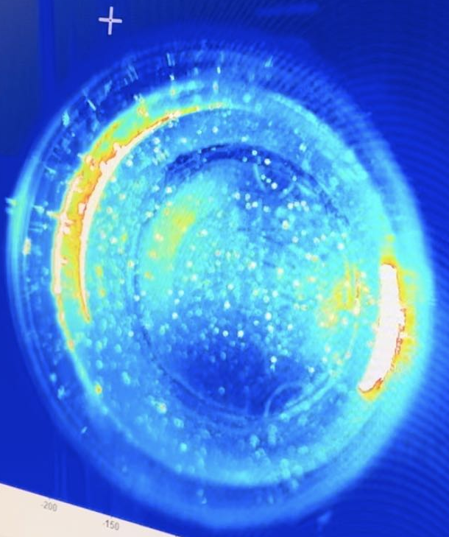
PIV system setting up from zero
We have two methods for visualizing the flow field:
1. When we only need to observe objects on the water surface, we can use ultraviolet light to illuminate any small particles floating on the surface.
2. When we need to observe fully submerged objects, we use a laser to illuminate the corresponding depth to track the relevant particles.

Slide 7
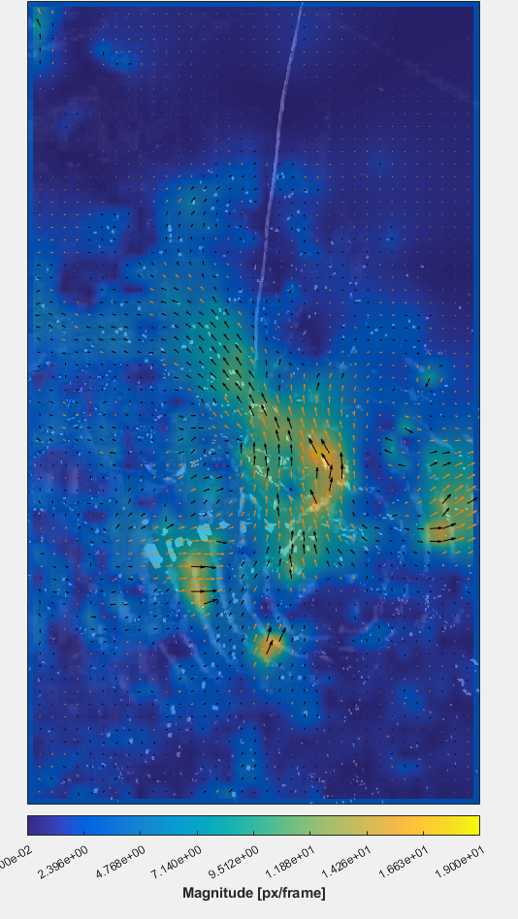
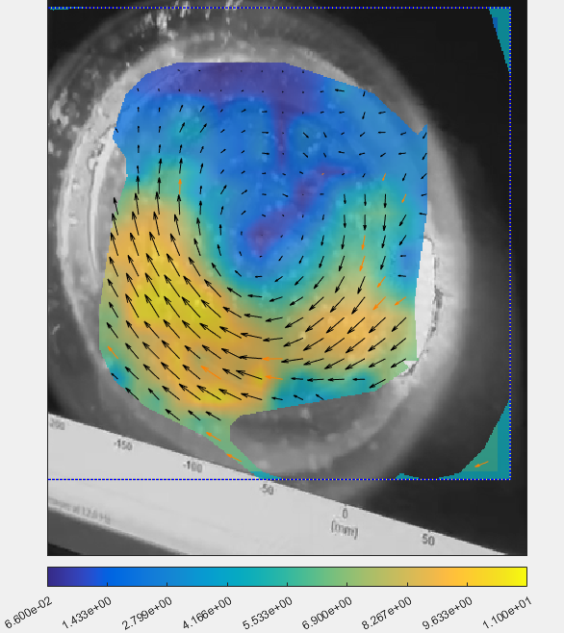
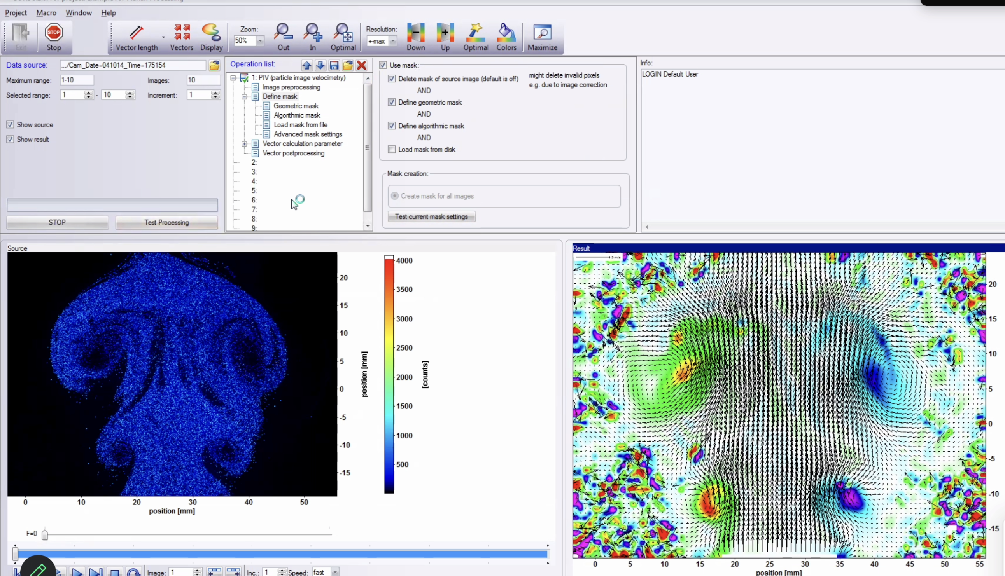
Flow velocity field calculation
For calculating the flow field, we have two different methods:
1. For photos captured using an external camera and ultraviolet light, we can calculate the flow field using the PIV add-on in MATLAB.
2. For photos captured using the camera equipped with LaVision and a laser, we can use DaVis software as a professional tool for processing the flow field.

Slide 8
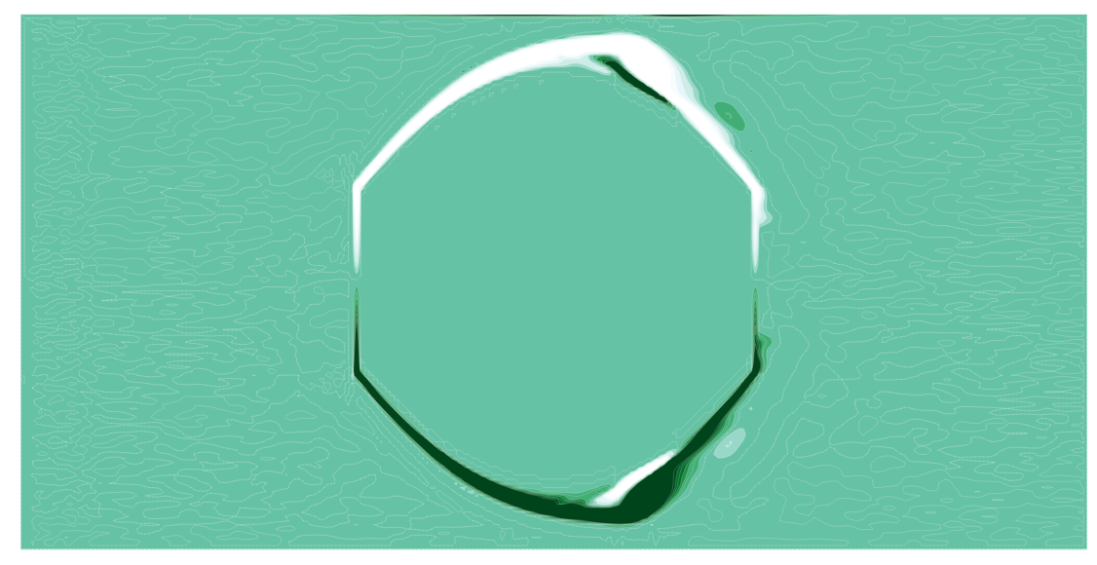
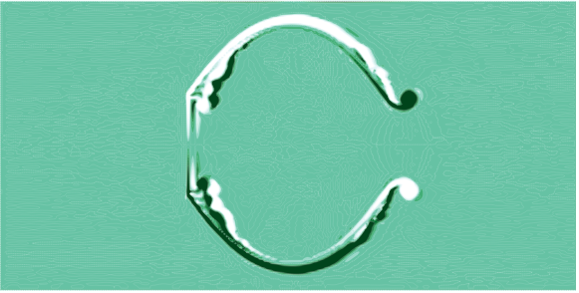
Robotics simulation
The WaterLily library is being utilized to develop a robotic model, with the model described using the Julia language. A 2D model of the robot has been successfully implemented, which will be validated against experimental data to confirm the reliability of the simulation. This approach enhances experimental efficiency by identifying effective robotic geometries for fabrication, eliminating the need to produce multiple prototypes for testing.
No inflow, 1 second
Inflow allowed, 1 seconds

Slide 9
Future Work
Trying to contribute the model of the robot based on ENN. for the data processing, I prefer use machine learning.
Trying to extend my master’s thesis to a paper as the first author.
Trying to extend one single robot to multi-robot system

